Slide 1

Azure OpenAI: Information Assistant
David Waxman
WWPS Industry Accelerators

Slide 2
What is an Industry Accelerator
Microsoft is making investments to make our technology easier to use and deploy for customers and partners.
We understand the significant investment in time, expertise and resources necessary to leverage many of these cutting-edge AI/ML capabilities.
To frame how these industry accelerators can be applied to your mission, the industry accelerators are designed around specific industry use cases.
The accelerators are a combination of code, documentation and education that we provide at no charge to customers and partners to accelerate the “time to value” when using Microsoft.
Industry Accelerators don’t replace any products and tools you already own, they make them better.

Slide 3







Industry Accelerator Library
OpenAI Information Assistant
(Under Construction)
Open-Source Intelligence
Multi Intelligence (MINTED)/Digital Evidence Triage
Electronic Invoicing Anomaly Detection
Hybrid Cloud Security
Flight Simulator
(Under Construction)
Unstructured data triage, enrichment and analysis
Structured
Security
Gaming
Notes:
Here is the waterfront of accelerators that we have built and continue to make investments in.
There are clear themes.. Processing unstructured data remains one of best and most in demand use cases and we have developed OSINT and MINTED and are working on Open AI as we speak.

Slide 4

Key Challenges with Large Language Models
Dated Models/Information
Inability to use Private Datasets
Fabrications
Lack of Citations/References
Lack of clarity on “Thought Process”

Slide 5
Key Challenges with OpenAI/GPT Models at present (Content Generation / Completion Functionality)
Dated information – Once a model is trained, it is “complete”, new information is not added, meaning that the data being used by the model at the time of it’s training is the last thing it knows. It does NOT stay “current”
Domain specific accuracy – While GPT models are trained on a very large dataset, it still does not have access to private/domain specific knowledge in many cases. In order for GPT-3 to answer any domain specific questions accurately, it’s essential that it’s able to leverage private/domain specific content.
Hallucinations - When GPT models do not know an answer it can fabricate answers which sound plausible. This is called a “Hallucination”. This makes it difficult to know when to trust the answers from GPT-3 when it’s used in a Q&A/chat pattern.
Citations/References – GPT models do not provide any provenance for its responses.
Methodology – GPT models does not provide details on it’s “thought process” further complicating how much trust you can put on responses provided by the model.

Slide 6
Azure OpenAI: Information Assistant
Create an “assistant” that will enable users to “Have a conversation with their private/domain specific data” by leveraging the power of a large language model where the responses are
Current - Responses can be based on the latest “up to date” information
Relevant – The responses must leverage their own private/domain specific data
Controlled - Provide the ability to adjust the response from precise to creative
Referenced – Respond using references/citations
Personalized - Respond with your role/persona in mind
Explainable - Providing details on the “thought process” that was used

Slide 7
Live Demonstration
Microsoft Confidential – Internal Use Only

Slide 8
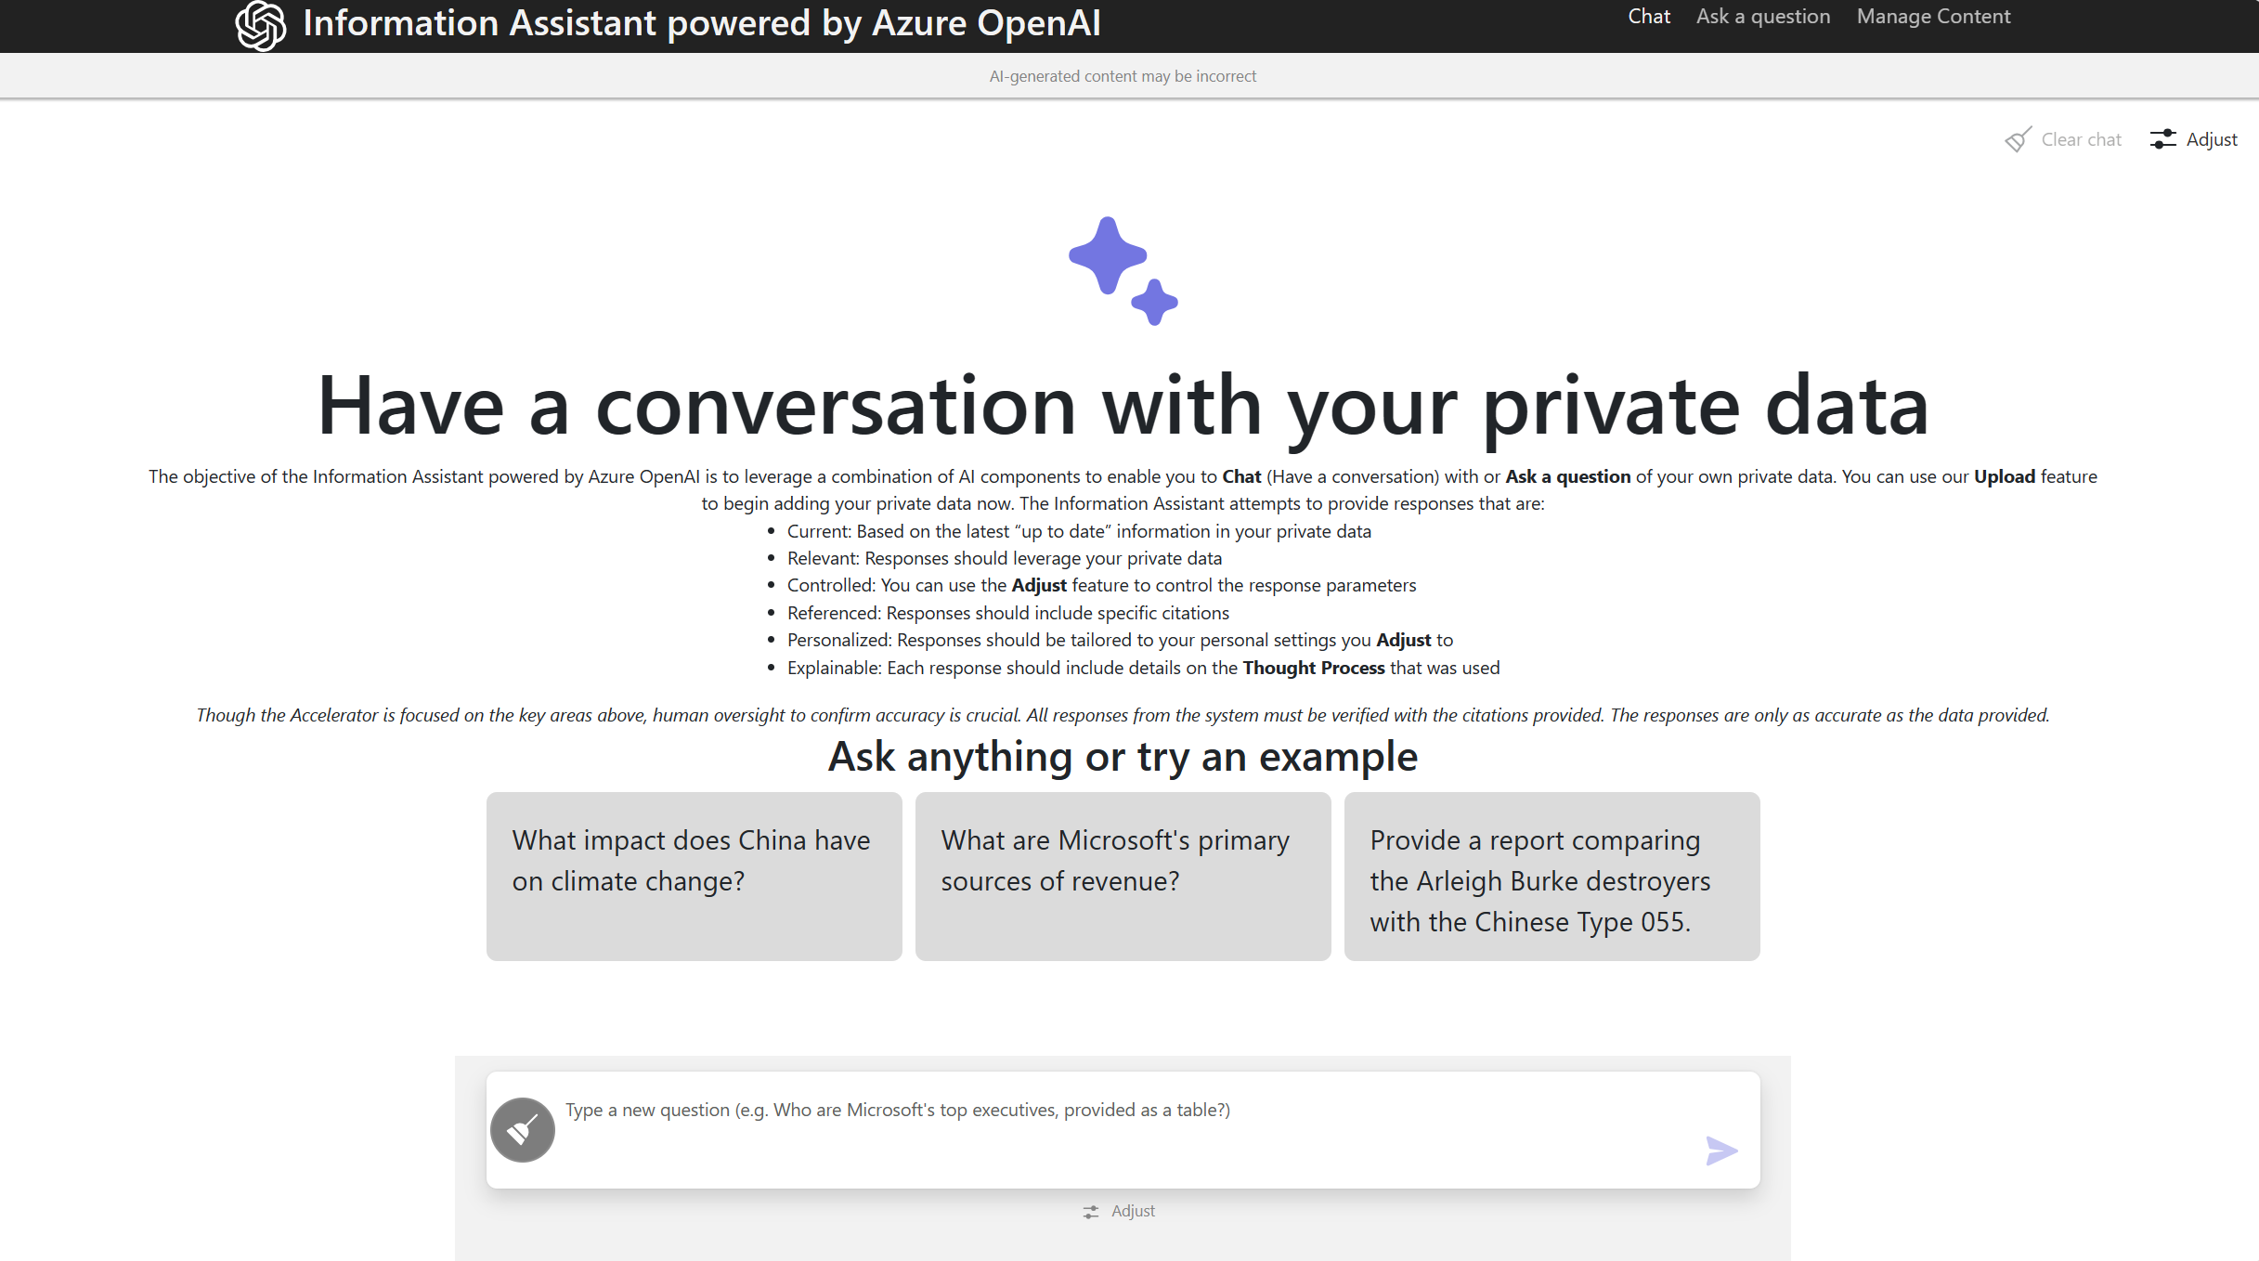
Simple Interface

Slide 9
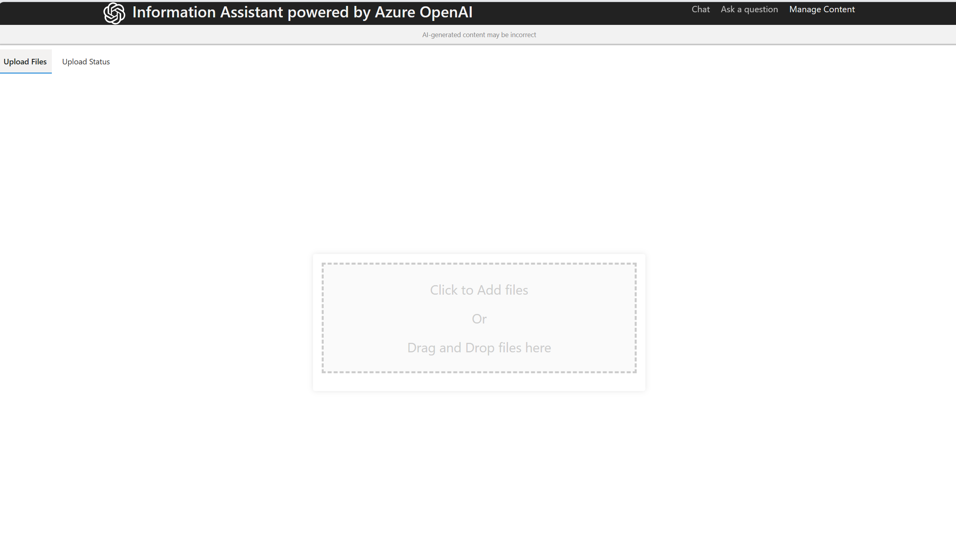
Easily add your own data

Slide 10
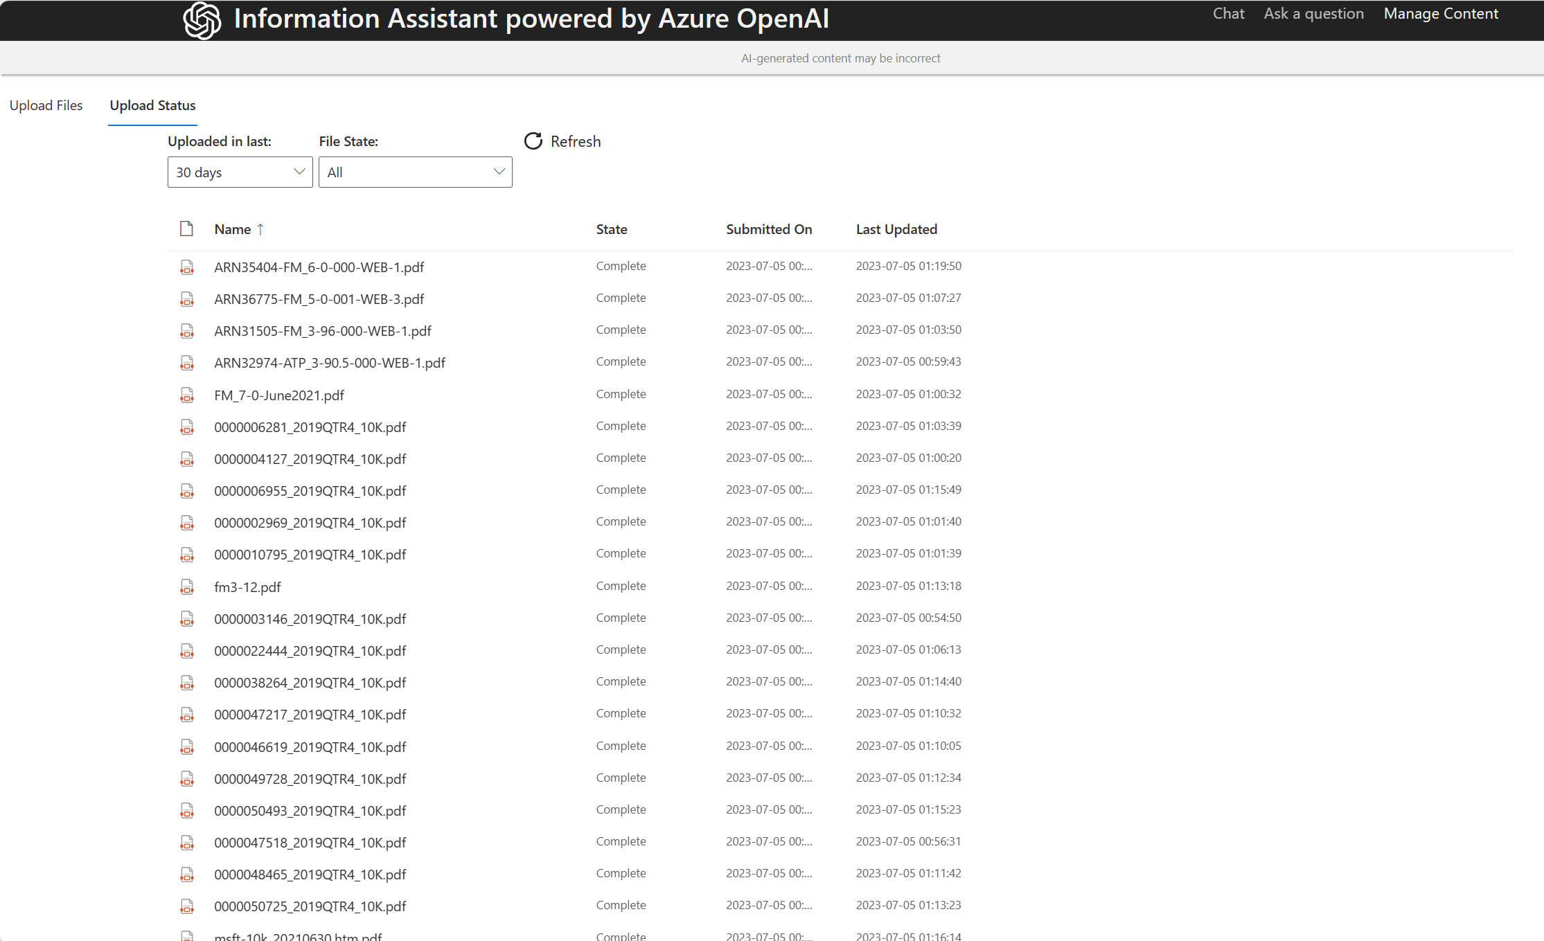
Check the status of your uploaded files

Slide 11
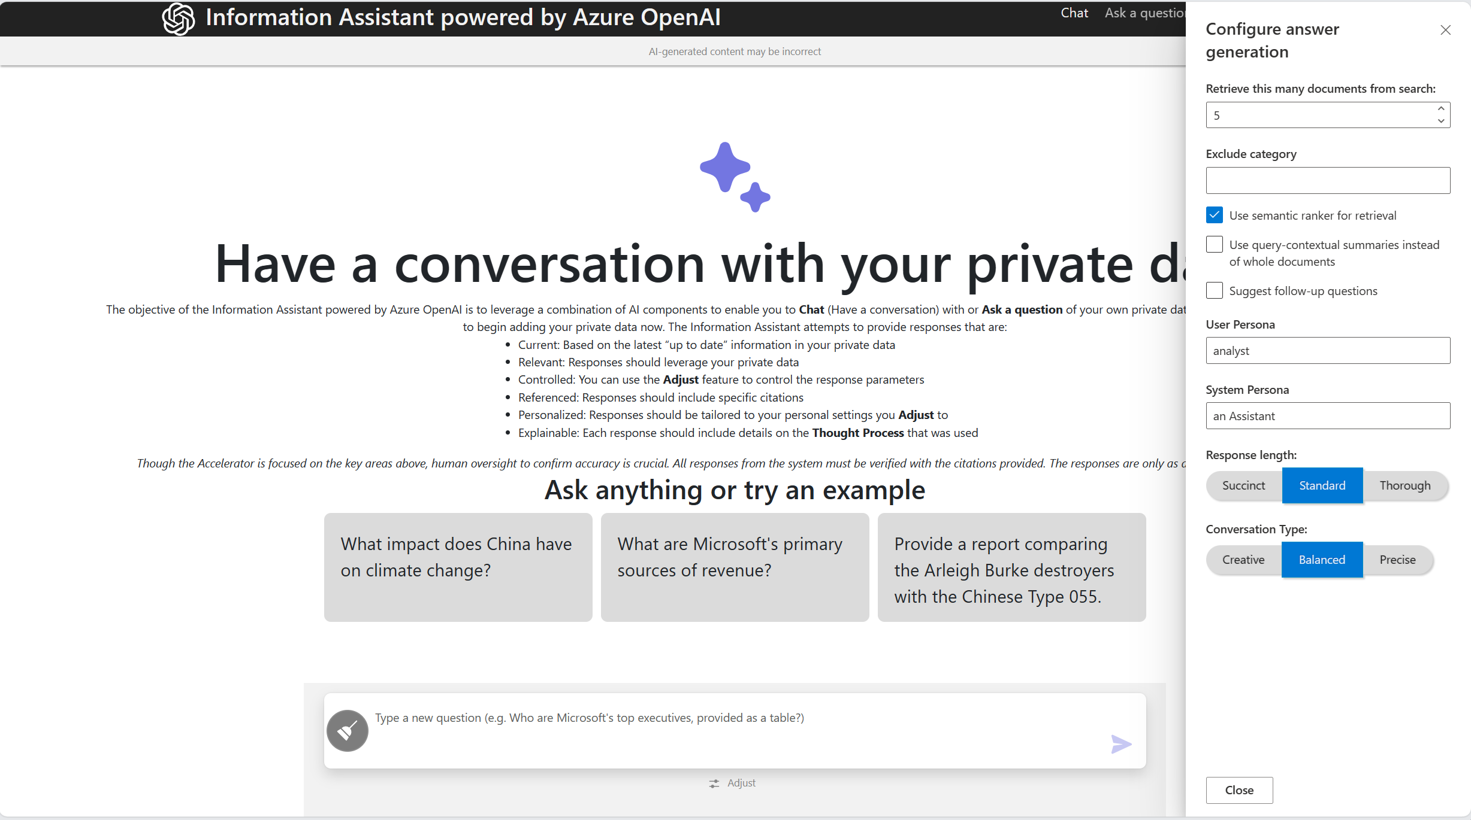
Control / Personalize the Response

Slide 12
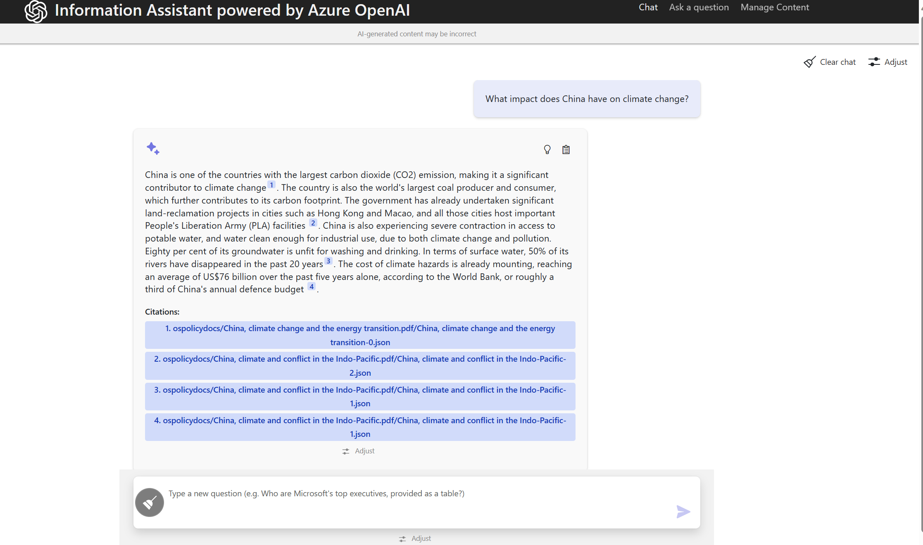
Examining Policies around Climate Change
Citations/References for every response

Slide 13
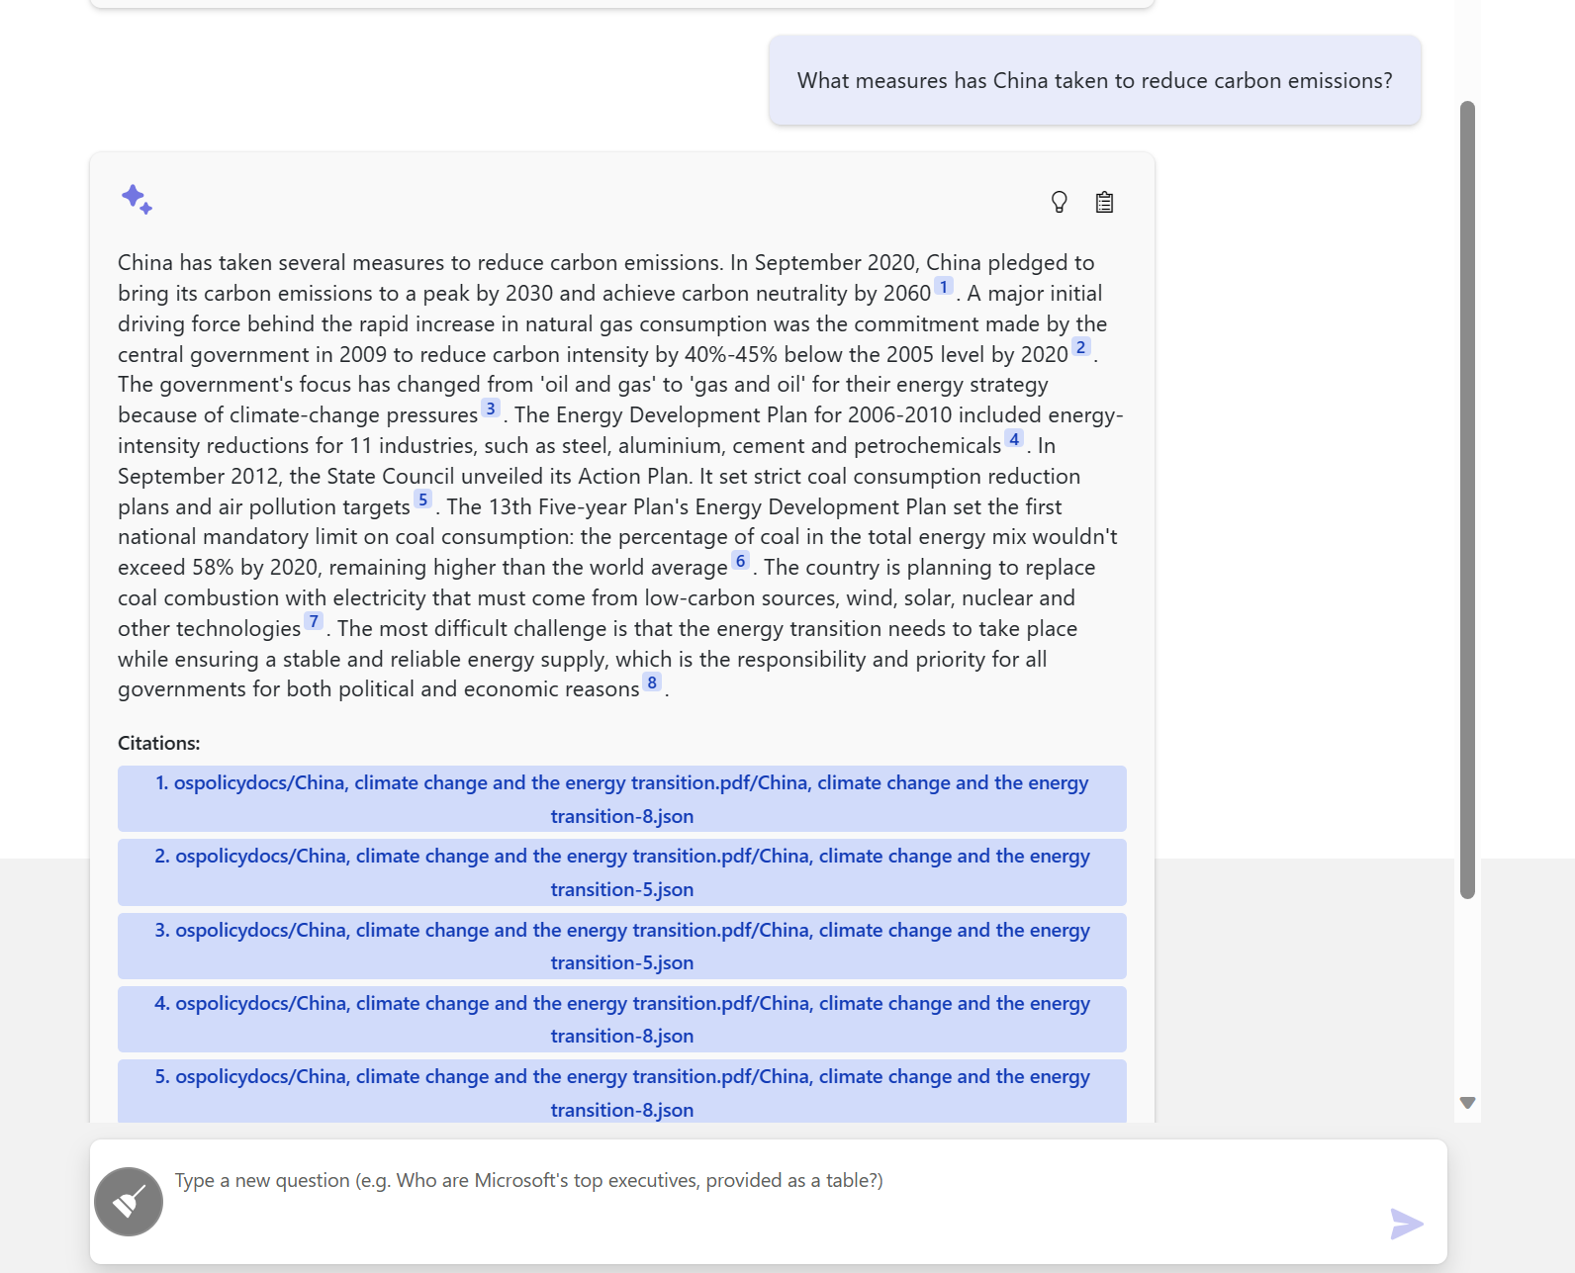
Ask additional questions in a “chat”

Slide 14
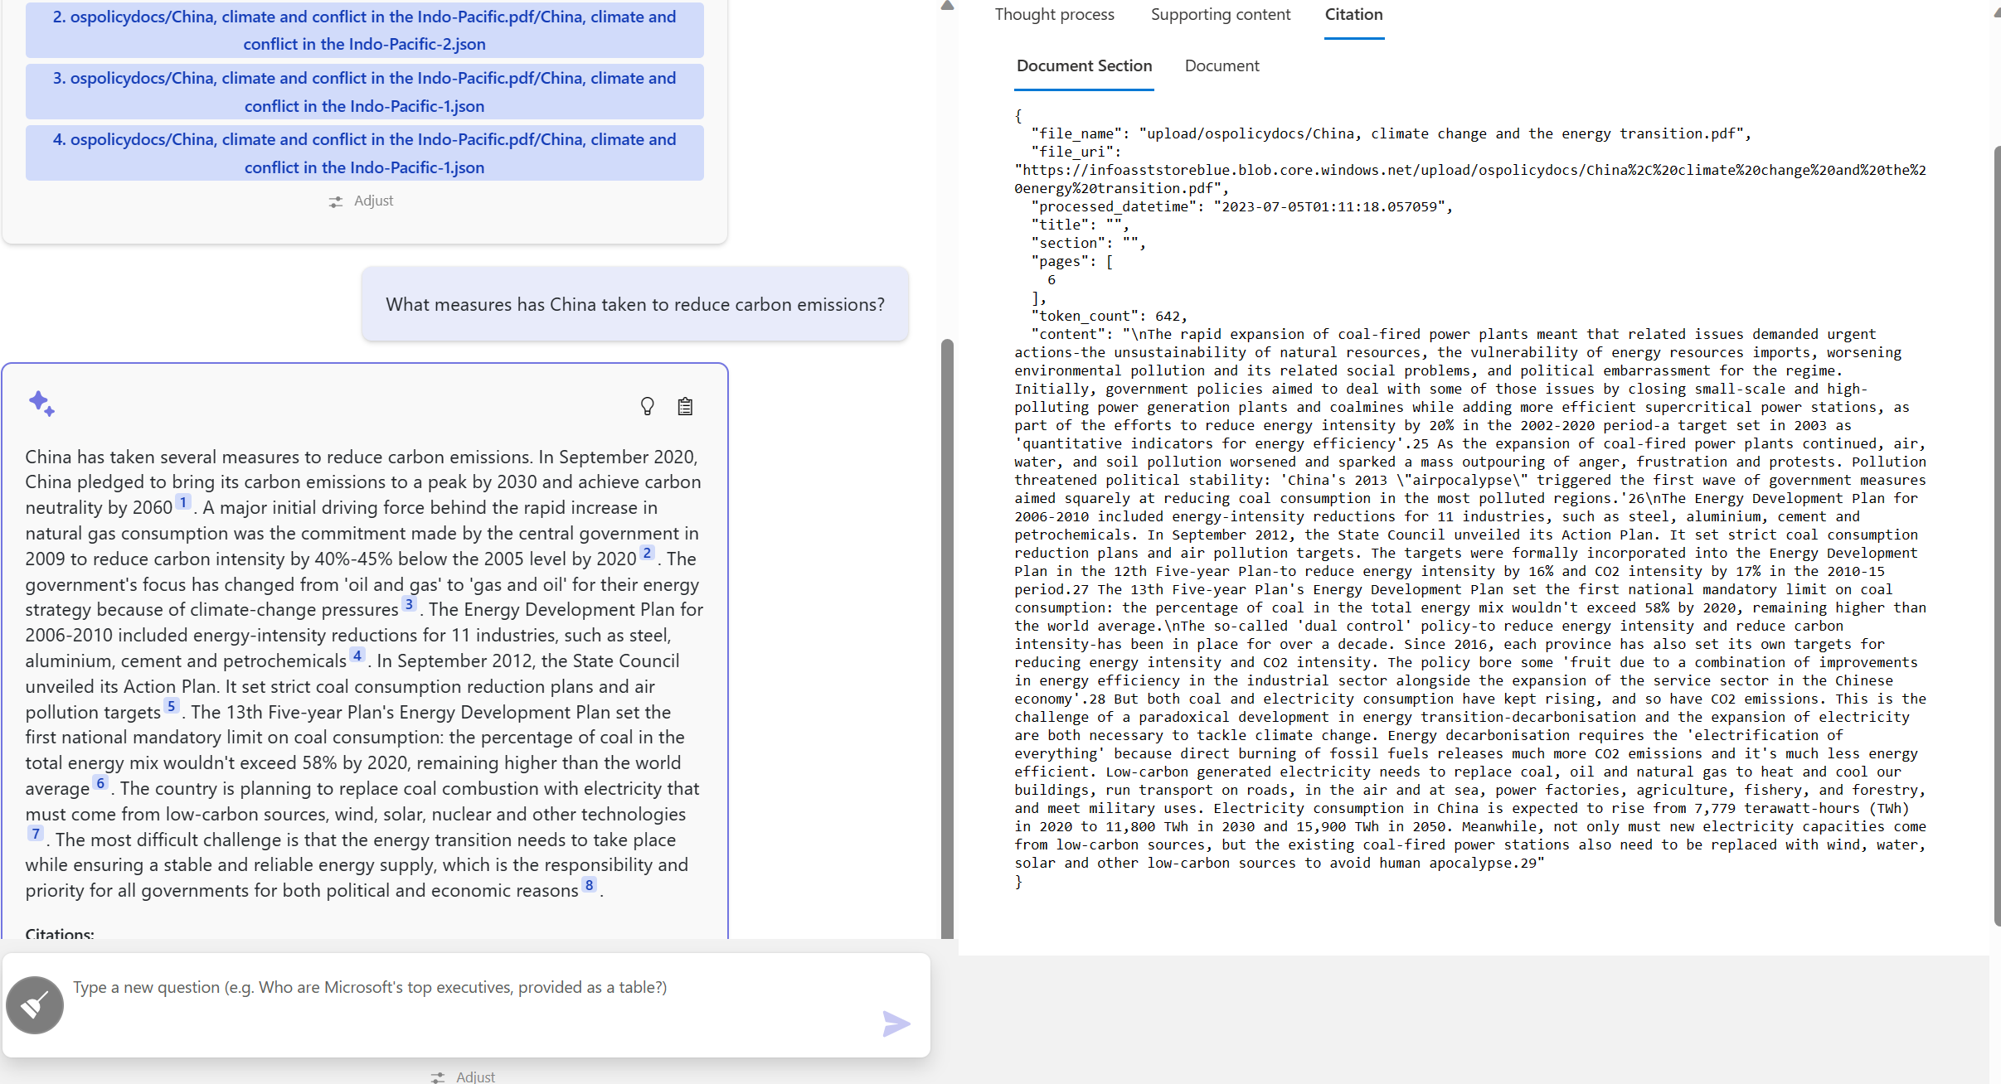
Examine the Citations/References

Slide 15
Understand the “context”

Slide 16
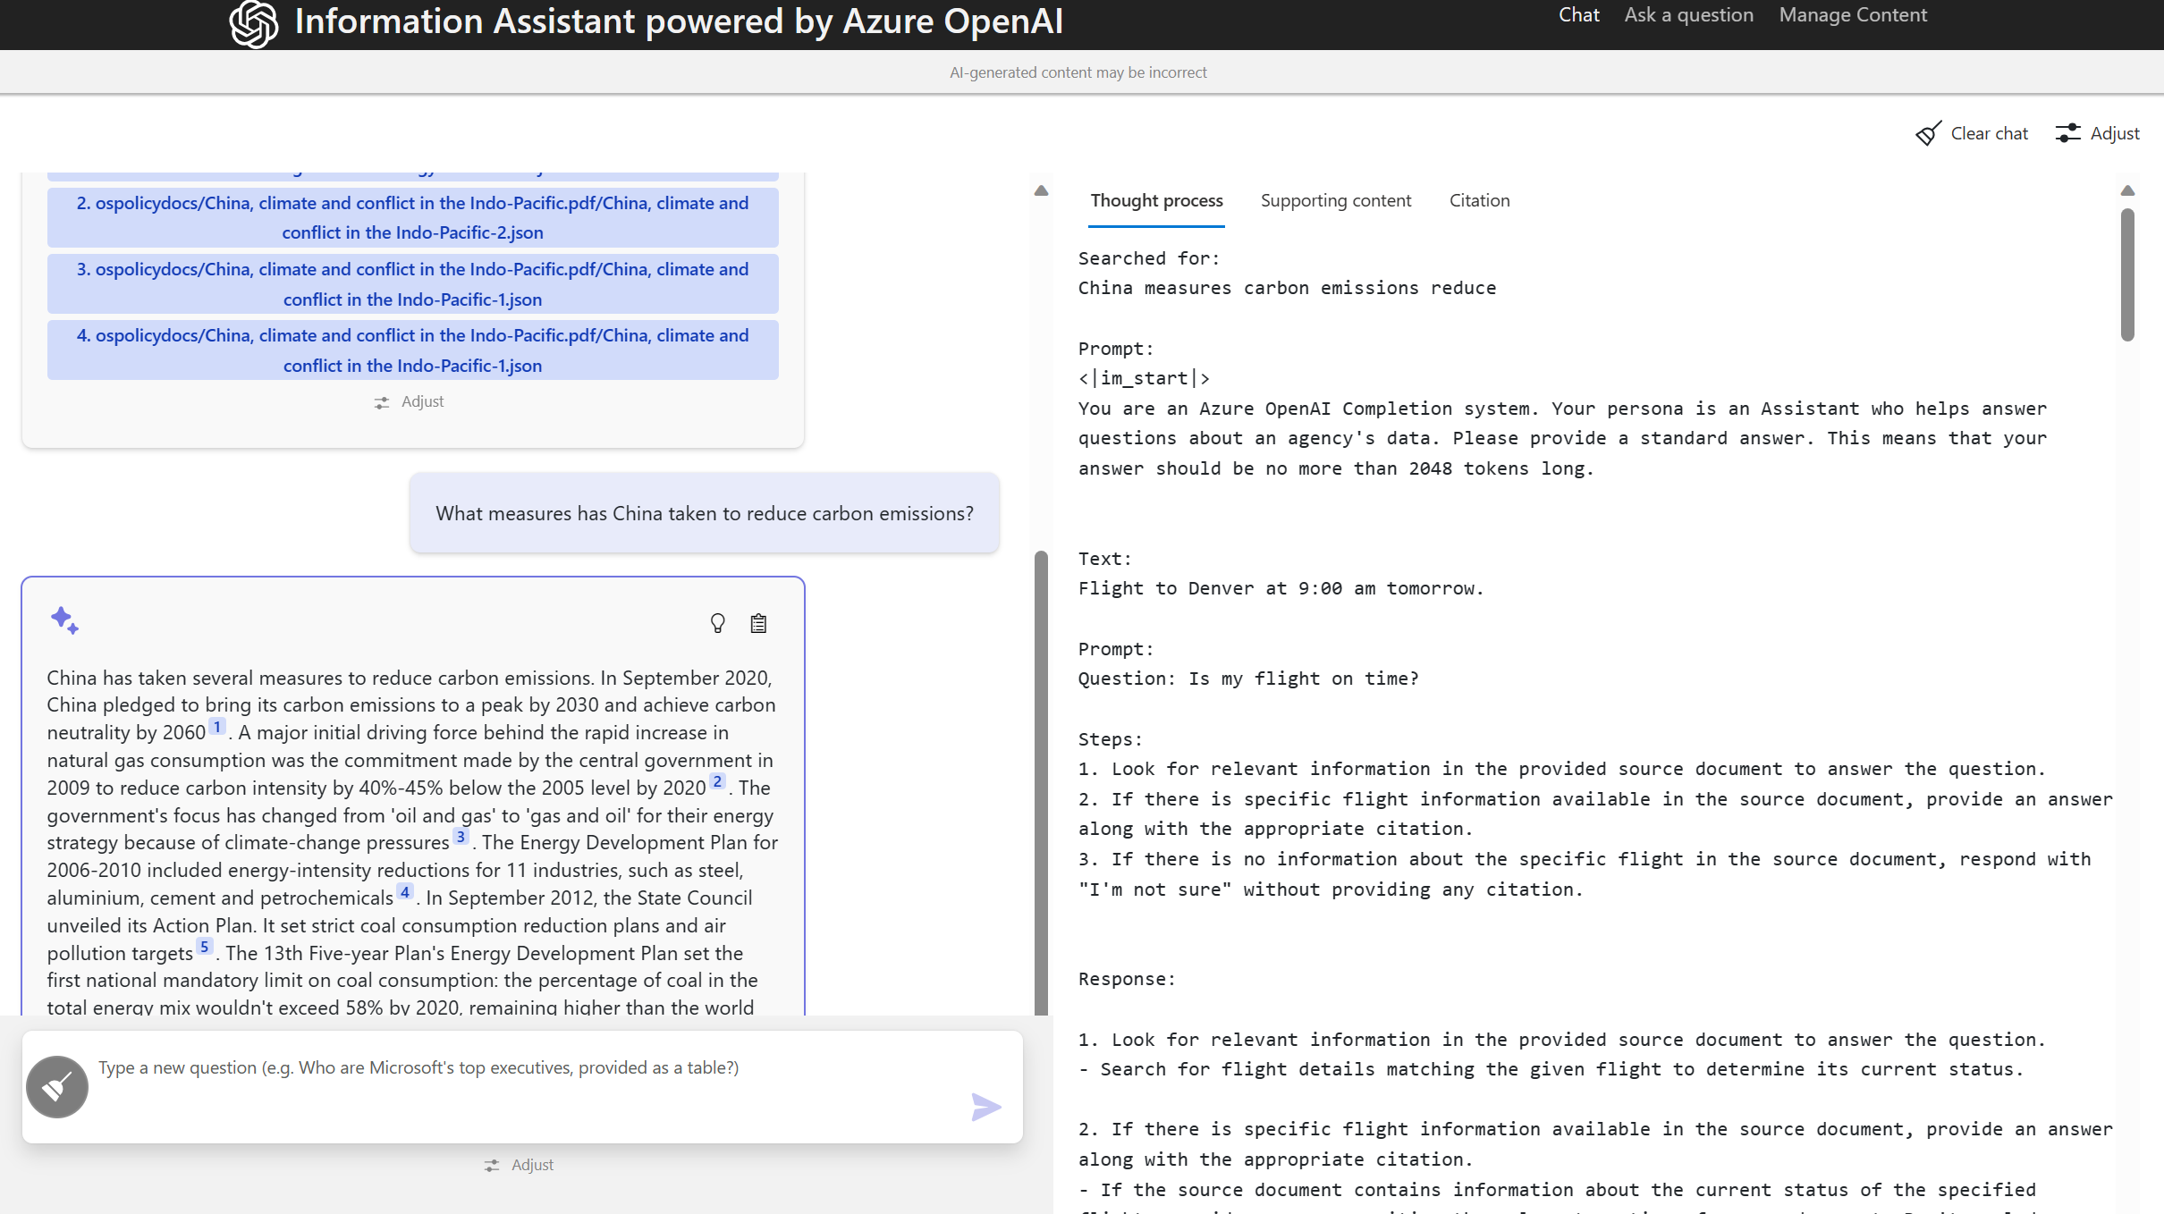
Understand the “Thought Process”

Slide 17
How does it work
Microsoft Confidential – Internal Use Only

Slide 18






OpenAI vs Azure OpenAI vs Cognitive AI
OpenAI
Private Network
Public Internet
Azure OpenAI
Private Network
Public Internet
Azure Cognitive AI
Private Network
Public Internet

Slide 19





Azure OpenAI Architecture
Azure Global Infrastructure
Customer Private Tenant / Subscription
Completion
Azure hosted OpenAI
Generative AI output
Prompts
GPT-3
DALL·E
Codex
Human or API driven input
chatGPT

Slide 20
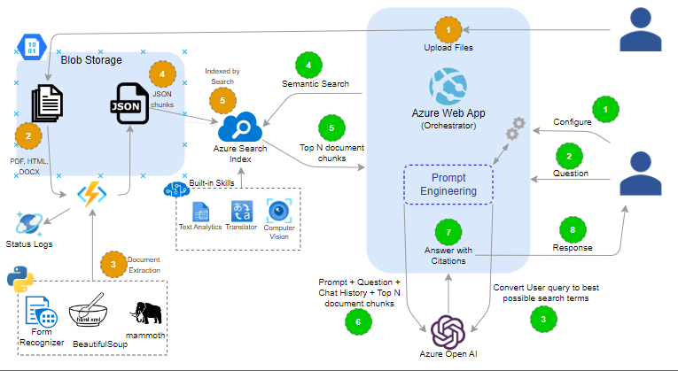
Conversation with Private/Domain Specific Data

Slide 21
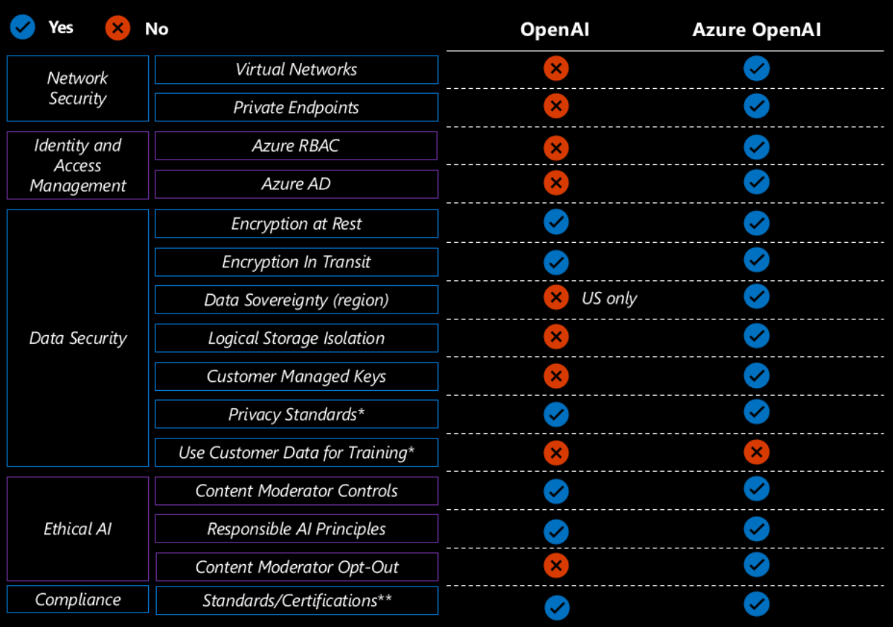
Security Controls
Source - (27) Peeling Back the Layers: Understanding the Multi-Faceted Approach to Azure OpenAI Security | LinkedIn

Slide 22
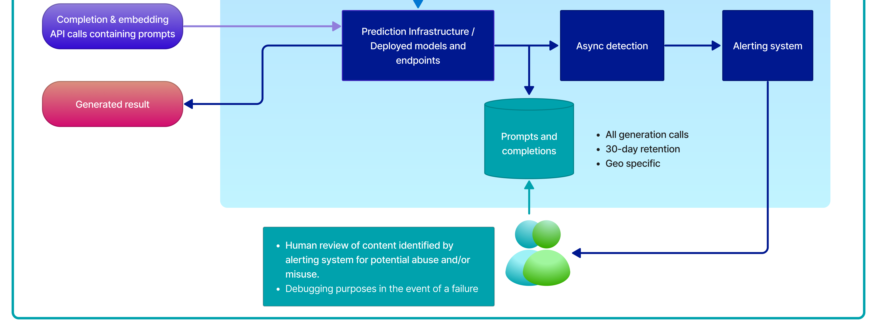
Data Retention
Prompts and completions. The prompts and completions data may be temporarily stored by the Azure OpenAI Service in the same region as the resource for up to 30 days. This data is encrypted and is only accessible to authorized Microsoft employees for (1) debugging purposes in the event of a failure, and (2) investigating patterns of abuse and misuse to determine if the service is being used in a manner that violates the applicable product terms. Note: When a customer is approved for modified abuse monitoring, prompts and completions data are not stored, and thus Microsoft employees have no access to the data.
Customers may request to modify content filtering and/or abuse monitoring by submitting the form here. If a customer is approved and remains in compliance with all requirements to modify abuse monitoring, then prompts and completions are not stored.
From OpenAI: Data Privacy Data, privacy, and security for Azure OpenAI Service - Azure Cognitive Services | Microsoft Learn

Slide 23
How is the Information Assistant different from other activities which look/sound similar?
Microsoft Confidential – Internal Use Only

Slide 24

How Information Assistant is different
Many activities revolve around integrating multiple components to enable you to search a private dataset and have OpenAI generate a response based on the results of that search.
That’s a good start but not sufficient to have a conversation with the requisite quality for our public sector and commercial customers

Slide 25
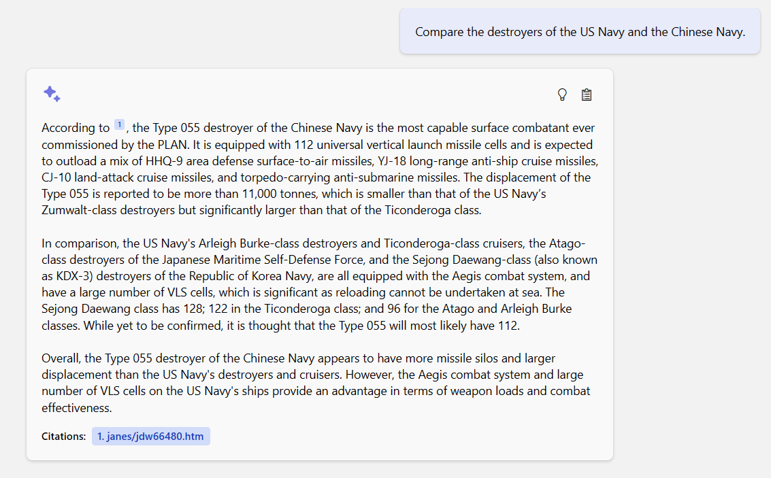
Just getting an answer isn’t enough, it needs to be accurate!
In this example the user asked for a comparison between US Navy and Chinese Navy destroyers. Unfortunately due to how the data was “chunked” additional, unrelated information crept into the response.

Slide 26
Sprint 6-7 Review- Technical Challenge investigations
Document Chunking | Understanding | Indexing | Querying | Prompt Engineering
PDF per page parsing | Azure Cognitive Search – Built-in skillsets | Azure Cognitive Search | Azure Cognitive Search - Semantic Search | Custom STUFFING technique- ReadRetrieveRead
PDF: Azure Form Recognizer HTML: Beautiful Soup DOCX: mammoth |  | Azure Cognitive Search – Vector Store (Preview) | Hybrid (Keyword + Vector | LangChain REFINE technique
Azure Cognitive Search – Text Splitter skillset | Azure Open AI Embeddings | FAISS | Co-sign Similarity | Chain-of-Thought prompting
LangChain tokenizer | Open-Source LM Embeddings | Pinecone | Custom Hybrid (Keyword + Vector) | Chat/Completion + DataSource grounding
Rejected
In Codebase
In Development
In Evaluation
Future Target

Slide 27
Key Focus Areas
Accuracy
Focusing on the science and technologies required to provide the “right” answer to the prompt
Context
Provide the ability to understand the “chunk” within the context of a larger document (Title, section, page, date etc.)
Multi-Lingual
Multi-Lingual Operation and Accuracy
Control
Length of response
Data Sources, Date Range, Author etc that are used for the response
Role Based Access
Format
Tabular/structured data
Personalization
Tailoring the response with a specific persona in mind (Speaker and Receiver)

Slide 28
Information Assistant Accelerator: What’s in the box
Custom Configuration Code
Deployment Kit
Cost Calculator
Documentation
Adoption Workshop Content (2 sessions, 4 hours each)
App Services, Application Insights, Azure Cosmos DB,
Azure Form Recognizer, Azure OpenAI, Azure Cognitive Search, Azure AD Application Registration, Azure Active Directory, Log Analytics workspace, Storage account
Parameterized Scripts and Installation Guide to rapidly spin up your own instance on your own tenant
Enables customers/ partners to examine cost components impacting users/capacity/
performance
Architectural Diagrams, Service Configurations, Documentation to assist with Accreditation on Classified Networks
A combination of virtual assets and direct customer assistance to stand up the accelerator in a customer or Partner’s Azure instance

Slide 29
THANK YOU
Microsoft Confidential – Internal Use Only

Slide 30
How it works
Document Processing
Context Extraction
Data Chunking
Indexing of Data Chunks
Enrichment of Data Chunks
Control / Personalize the response
User Persona
Speaker Persona
Response Length
Precision <-> Creativity
Generate Prompt
Question/ Prompt Processing
User enters the Question
Converting Question into Search Terms
Query Index
Using Search Terms
Return Top N Document Chunks
Generate Response
Combine
Question
Prompt Engineering
Chat History
Top N Chunks
Generate Response with Citations

Slide 31
How it works
Document Processing
Context Extraction
Data Chunking
Indexing of Data Chunks
Enrichment of Data Chunks
Control / Personalize the response
User Persona
Speaker Persona
Response Length
Precision <-> Creativity
Generate Prompt
Question/ Prompt Processing
User enters the Question
Converting Question into Search Terms
Query Index
Using Search Terms
Return Top N Document Chunks
Generate Response
Combine
Question
Prompt Engineering
Chat History
Top N Chunks
Generate Response with Citations

